Slide 1


Introduction
Welcome to our presentation on the leak of Cash App's customer data by a disgruntled employee. We will delve into the details of this real-life example of an insider threat, exploring the causes, consequences, and valuable lessons learned.

Slide 2

What is Cash App?
A Mobile Payment App
Developed by Square, Inc.
Convenient and Secure Transactions
Cash App is a popular peer-to-peer mobile payment application that allows users to send and receive money instantly, as well as buy and sell Bitcoin and stocks.
The app was created by the financial technology company Square, Inc., co-founded by Twitter co-founder Jack Dorsey.
Cash App offers a user-friendly interface and robust security features, making it a convenient choice for personal and business transactions.

Slide 3
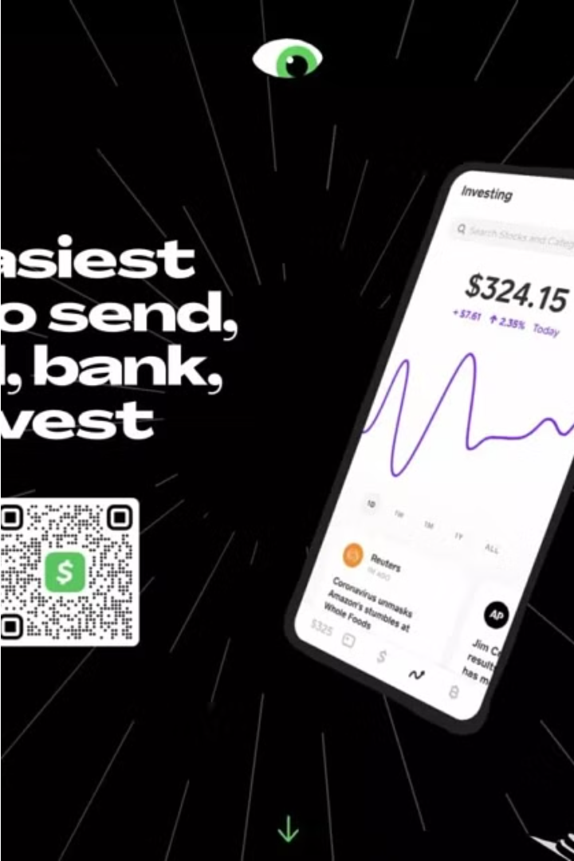
The Data Breach Incident
In 2021, a disgruntled Cash App employee stole sensitive customer data and leaked it online. The breach compromised the personal and financial information of millions of Cash App users, including their names, account balances, and transaction histories.
The incident caused significant damage to Cash App's reputation and eroded customer trust, leading to a steep drop in app downloads and user engagement.

Slide 4

How the Breach Occurred
Disgruntled Employee
1
A disgruntled former employee of Cash App, upset over a recent termination, stole sensitive customer data from the company's servers.
2
Data Exfiltration
The employee secretly downloaded the customer information, including names, account details, and transaction histories, before deleting their access.
Covering Tracks
3
To cover their tracks, the employee used advanced techniques to bypass security measures and conceal the data breach from Cash App's security team.

Slide 5
Sensitive Customer Data Exposed
Personal Information
Financial Exposure
Potential for Identity Theft
Reputational Damage
The leaked data included customers' names, email addresses, phone numbers, and financial information such as bank account details and transaction history.
With access to customers' banking credentials and transaction records, the malicious actor could potentially carry out fraudulent activities and cause significant financial harm.
The exposure of personally identifiable information put Cash App customers at risk of identity theft, with the ability for the hacker to open new accounts or take out loans in victims' names.
The data breach was a major breach of trust, undermining Cash App's reputation as a secure and trustworthy financial service provider.

Slide 6
Impact on Cash App and Customers
1
Widespread Exposure of Sensitive Data
2
Erosion of Customer Trust
The data leak severely damaged Cash App's reputation and eroded customer trust, leading many to question the company's ability to safeguard their sensitive information.
The breach resulted in the exposure of millions of Cash App customers' personal and financial information, including full names, brokerage account numbers, and stock trading activity.
3
Financial Losses and Liabilities
4
Increased Cybersecurity Concerns
Cash App faced significant financial losses from the breach, including the costs of investigations, legal proceedings, and potential customer compensation claims.
The incident heightened concerns about the company's cybersecurity practices and the need for stronger data protection measures to prevent future breaches.

Slide 7
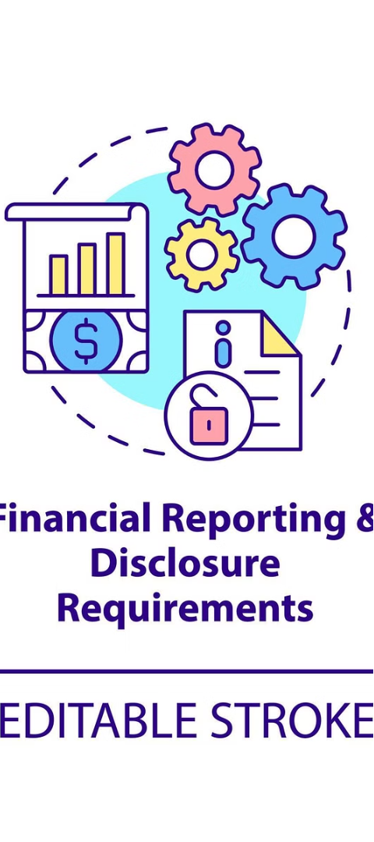



Regulatory Implications
Regulatory Scrutiny
The data breach at Cash App has attracted significant regulatory attention, as the company is subject to strict financial data protection laws and oversight.
Potential Penalties
Cash App may face hefty fines and penalties from regulatory bodies like the FTC and SEC for failing to adequately protect customer information.
Compliance Audits
Regulators will likely conduct thorough audits of Cash App's security practices and data management policies to ensure they meet industry standards.

Slide 8

Lessons Learned
The Cash App data breach incident highlighted the critical importance of robust insider threat monitoring and data security protocols. Disgruntled employees can pose a serious risk, with the ability to access and misuse sensitive customer information.
This breach underscores the need for comprehensive employee background checks, strict access controls, and continuous monitoring of internal systems and user activities. Companies must also prioritize employee well-being and address potential sources of dissatisfaction to mitigate the threat of malicious insiders.

Slide 9




Importance of Insider Threat Monitoring
Proactive Surveillance
Data Protection
Risk Mitigation
Regulatory Compliance
Insider threat monitoring safeguards sensitive customer information by identifying and mitigating data breaches from malicious insiders.
Effective insider threat monitoring reduces the likelihood and impact of breaches, protecting the company's reputation and financial well-being.
Continuous monitoring of employee activities can help detect suspicious behaviors and potential insider threats early on.
Robust insider threat monitoring programs help organizations meet stringent data privacy and security regulations, avoiding costly fines and penalties.

Slide 10

Conclusion and Recommendations
The Cash App data breach serves as a stark reminder of the importance of robust insider threat monitoring and security practices. To prevent similar incidents, Cash App should enhance employee screening, implement stringent data access controls, and bolster its cybersecurity training programs.

